Slide 1
Class Diagrams

Slide 2
So far
Modelling
Use case diagram
    High level view of functional requirements
Use case description
    Detailed view of functional requirements
Use case template
Use case scenarios
  Normal / Alternative / Exceptional
Domain models

Slide 3
Use Case Modelling
A More Realistic Approach
Develop
Use Case
Descriptions
Develop
Scenarios
Iterative?
Develop
Use Case Diagram
Notes:
3

Slide 4
Classes
Generic type of thing
Objects are the individual things
Classes are templates for creating instances or objects
  Concrete
  Abstract
Typical examples:
  Application domain, user interface, data structure, file structure, operating environment, document, and multimedia classes
Quick Exercise – in 1 minute
  Identify the classes in this room?
Lecturer, Student, Furniture, Computer, Projector, etc

Slide 5
Attributes
Facts related to a type of thing
  Attributes of a class
  Class – Car Attribute may include: Make, Model, Engine size, etc
Only attributes important to the task should be included
Quick Exercise – in 1 minute
  Identify attributes of the class Student?
RegNumber, Name, DateOfBirth, Gender, Email, etc

Slide 6
Operations
Behavior types of things do
  Class – Car, Operation – accelerate(), break(), etc
Action that instances/objects can take – defined by the class
Focus on relevant problem-specific operations (at this point)
Quick Exercise – in 1 minute
  Identify operations of the class Student?
makeNotes, answerExercise, doHomework, etc

Slide 7
Exercise 1 - Classes
A Cinema shows films. Each film has a title, a producer, a director, a length, certificate and a type. Patrons watch films at the cinema. Patrons are either adults or children and have a name and an age. To see a film a patron has to buy a ticket. A ticket has a price, a time and is for a film.
In groups of 3-4 spend 5 minutes
  identifying classes in the above scenario (HINT: 5 classes)
  The attributes of the classes

Slide 8
Exercise 1 – Solution Template
Class | Attributes

Slide 9
Exercise 1 – Solution
Class | Attributes
Film | Title, Producer, length, certificate, genre
Patron | Name, age
Adult Patron | Name, age
Child Patron | Name, age
Ticket | Price, time, film

Slide 10
Class Diagram
Mechanism for visualising classes
Became truly central within all object oriented methods
A Class Diagram shows
  Classes
    Attributes
    Operations
  Relationships
Which are consistent over time
Shows the structure of things and ideas in a system

Slide 11
Basic Diagram
Identify Classes
Draw a rectangle for each class
Name it

Slide 12
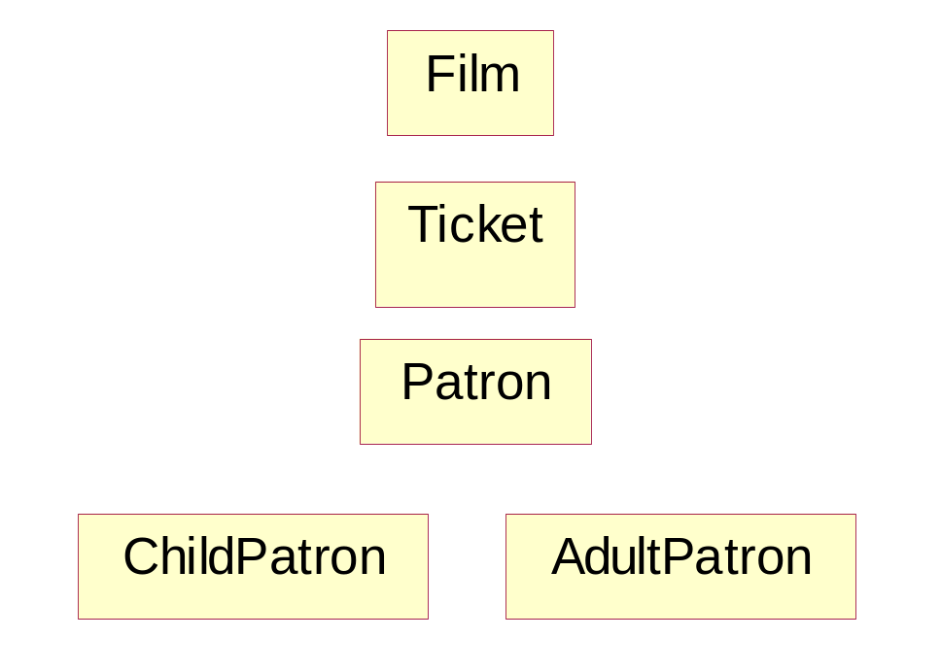
Drawing a Class Diagram
Identify Classes – Have a go?
Class | Attributes
Film | Title, Producer, length, certificate, type
Patron | Name, age
Adult Patron | Name, age
Child Patron | Name, age
Ticket | Price, time, film

Slide 13
Add attributes and operations
For each class identified
Identify attributes
  Facts associated with classes
Identify operations/methods
  Actions objects of the classes do
Re-factor
  Are the attributes in the right class?
  Are the operations in the right class?

Slide 14
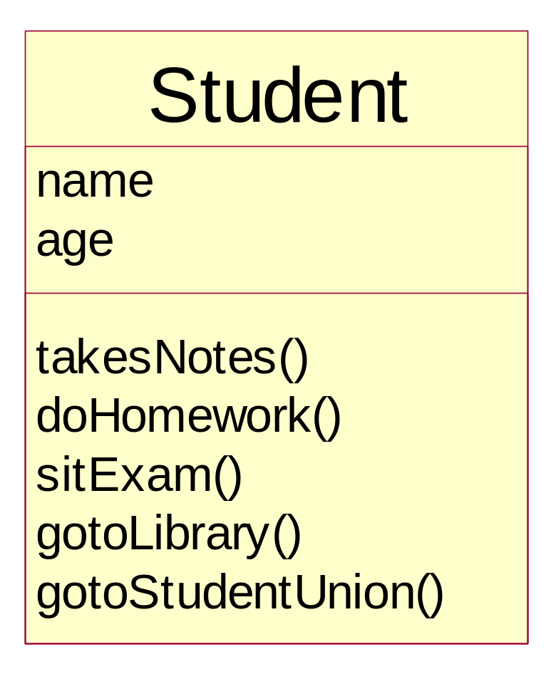
Simple Class Diagram
Class
Attributes
Operations

Slide 15
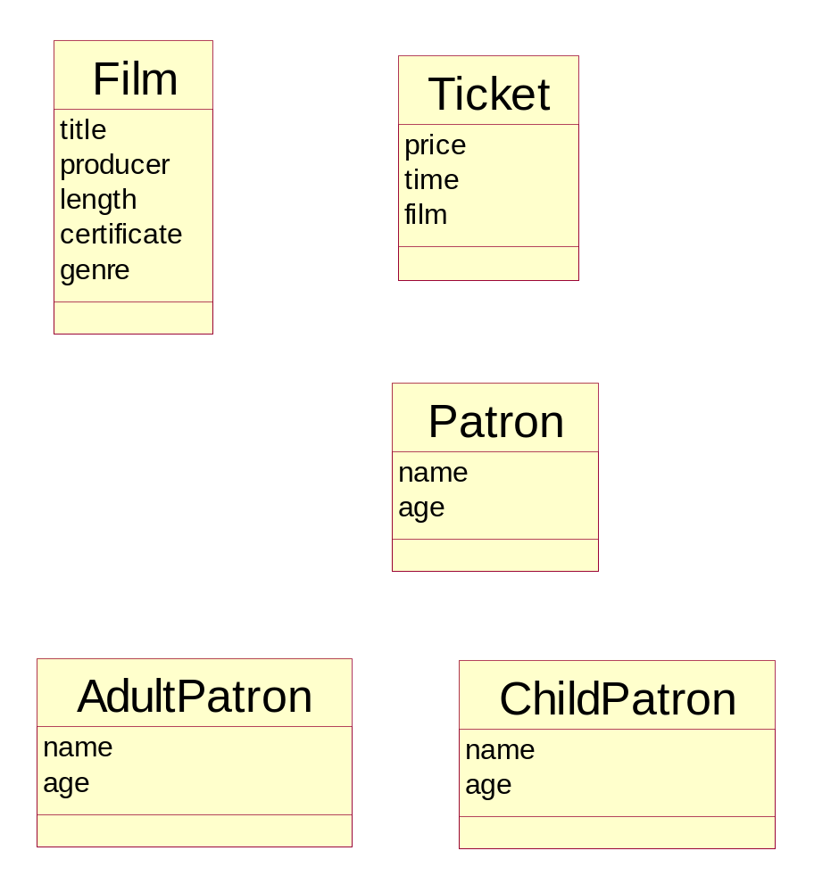
Drawing a Class Diagram
Identify Attributes – Have a go?
Class | Attributes
Film | Title, Producer, length, certificate, genre
Patron | Name, age
Adult Patron | Name, age
Child Patron | Name, age
Ticket | Price, time, film

Slide 16
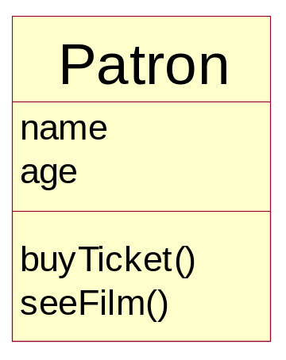
Drawing a class diagram
Identify operations
Just for the class “Patron” identify the operations
Patrons can
  Buy Tickets
  See Films

Slide 17
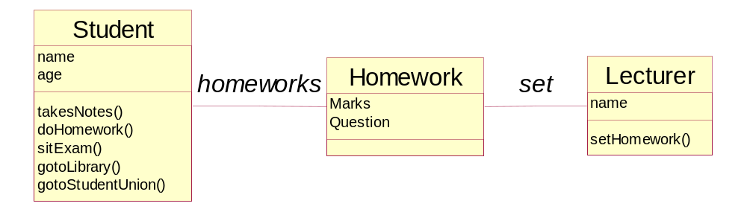
Relationship Example
Relationships are shown as a line connecting the two classes
Relationships should be named

Slide 18
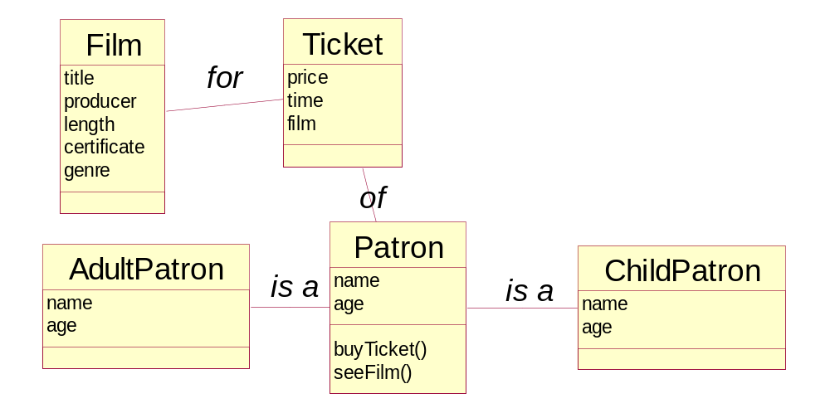
Creating a Class Diagram
Adding relationships
What relationships exist in the Cinema example.
Update the class diagram. Include:
  Relationships
  Relationship names

Slide 19
Relationships
Classes do not exist in isolation
It is important to consider how they
  Interact
  Relate
Tend to be VERBS
Five principal types of relationships

Slide 20


Type One - Association
Classes associated with / related to one another
Example
  Student studies a course
Very Commonly used
“Default” type of relationship
// class A
public class A
{
public B theB;
public A() { }
}
// class B
public class B
{
public A theA;
public B() { }
}
// class A
public class A
{
public B theB;
public A() { }
}
// class B
public class B
{
public B() { }
}

Slide 21
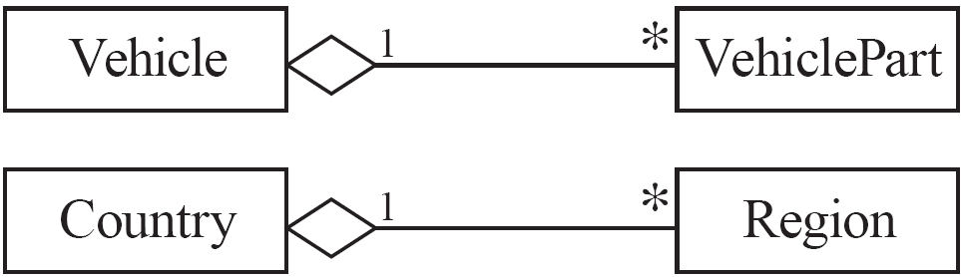
Type Two - Aggregation
  Aggregations are special associations that represent ‘part-whole’ relationships.
    The ‘whole’ side is often called the assembly or the aggregate
    This symbol is a shorthand notation association named isPartOf

Slide 22
When to use an aggregation
As a general rule, you can mark an association as an aggregation if the following are true:
  You can state that
    the parts ‘are part of’ the aggregate
    or the aggregate ‘is composed of’ the parts
  When something owns or controls the aggregate, then they also own or control the parts

Slide 23

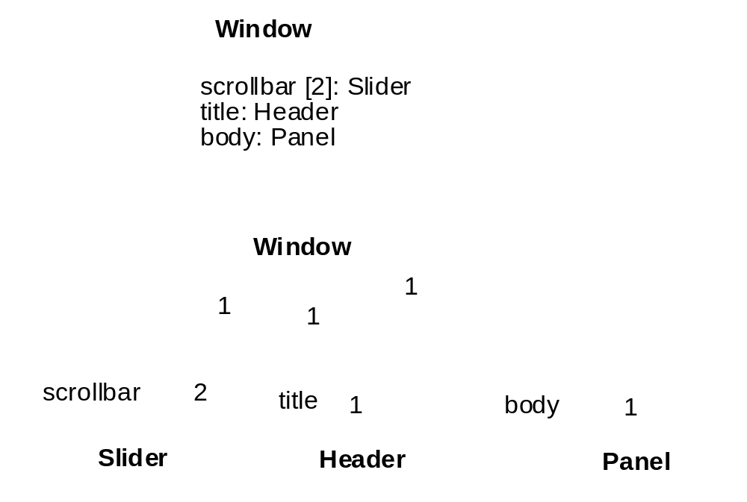
Type Three - Composition
Composition is a stronger variant of the "owns a" or association relationship; composition is more specific than aggregation
It is represented with a solid diamond shape
Has a strong life cycle dependency between instances of the container class and instances of the contained class(es): If the container is destroyed, normally every instance that it contains is destroyed as well

Slide 24

Type Four - Dependency
Dependency is a weaker form of relationship which indicates that one class depends on another because it uses it at some point of time
It exists if a class is a parameter variable or local variable of a method of another class

Slide 25
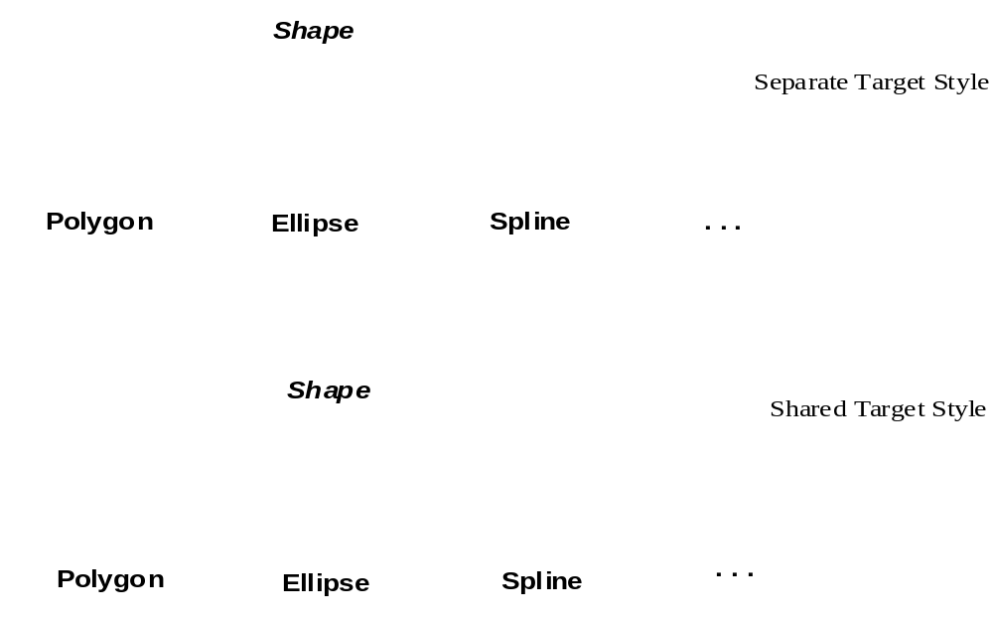
Type Five - Generalisation
Indicates that one of the two related classes (the subtype) is considered to be a specialized form of the other (the super type) and supertype is considered as 'Generalization' of subtype
In practice, this means that any instance of the subtype is also an instance of the supertype

Slide 26
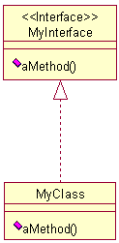
Abstract class and interface
interface MyAbstractClass . . . .
class MyClass implements MyInterface
{
. . . . .
}

Slide 27
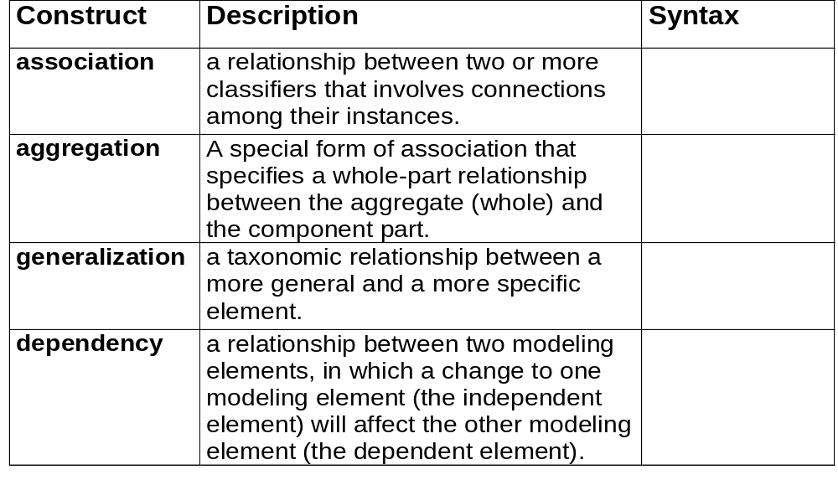





Core relationship
Reference: OMG tutorial on UML by Cris Kobryn

Slide 28
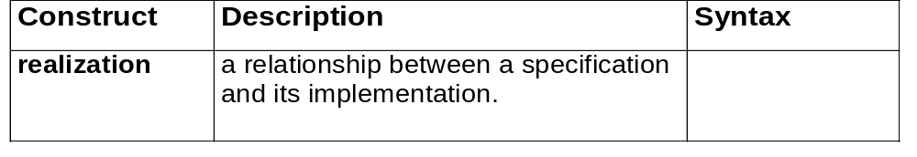

Core relationship

Slide 29
Exercise
A garage sells cars, accessories and car parts. The garage sells sport cars, sports utility vehicles and saloon cars.
In groups of 3-4 spend 5 minutes
  Draw the class diagram for this scenario
  Include relationships
  Include relationship types
  Ignore attributes and operations

Slide 30
One Solution
CarParts
parts
Car
accessories
Accessories
SportsUtility
SportsCar
SaloonCar

Slide 31
Exercise
Example 1
An Order has to come from a single Customer and a Customer may make several Orders over time. Each of these Orders has several Order Lines, each of which refers to a single Product.

Slide 32
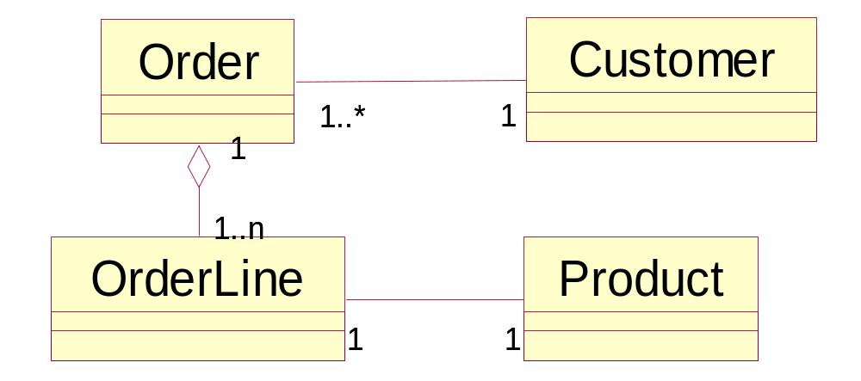
Exercise Solutions
Exercise 2

Slide 33
Entity class
Entity class
  Models long-lived information
Examples:
  Account Class
  Investment Class

Slide 34
Boundary class
Boundary class
  Models the interaction between the product and the environment
  A boundary class is generally associated with input or output
Examples:
  Investments Report Class
  Mortgages Report Class

Slide 35
Control class
Control class
  Models complex computations and algorithms
Example:
  Estimate Funds for Week Class

